Slide 1
One hidden layer
Neural Network
Gradient descent for
neural networks

Slide 2
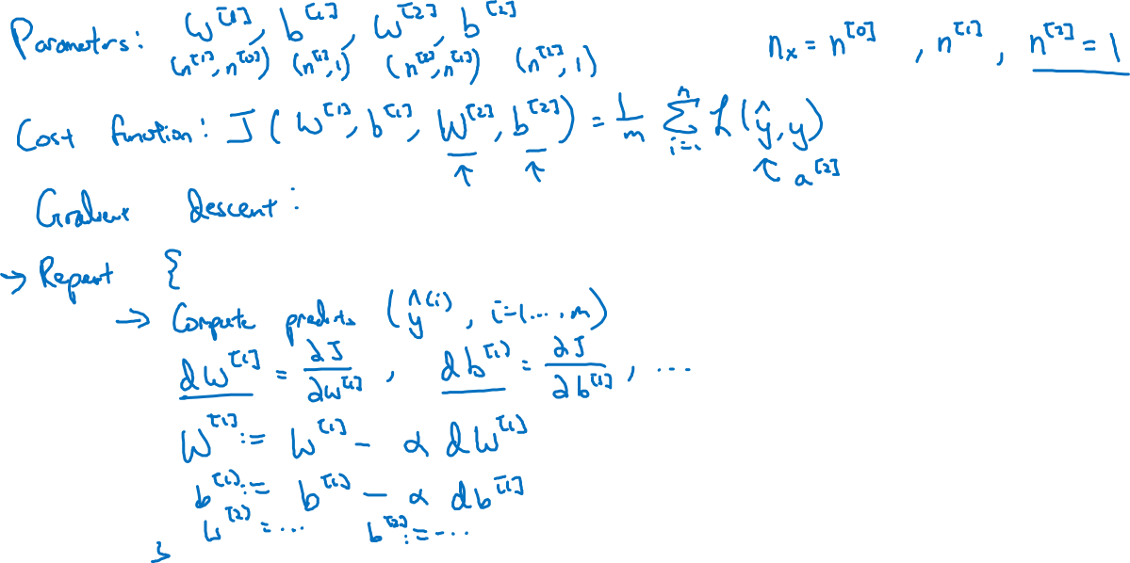
Gradient descent for neural networks

Slide 3
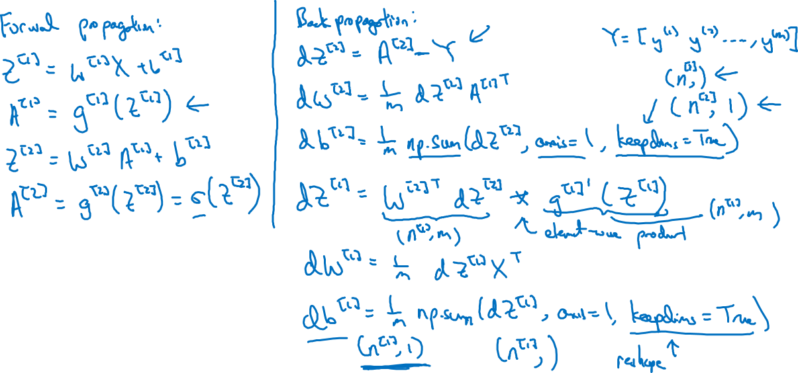
Formulas for computing derivatives

